Slide 1
ANALYZING THE GLOBAL IMPACT OF TRUMP’S TARIFFS USING SPATIAL ECONOMETRIC MODELS
Wilson john de tomas
May 2025

Slide 2
outline
Rationale
Research Objectives
Theoretical Framework
Data and Variables
Methodology
Interpretation and Conclusion
References

Slide 3
Rationale
Tariffs create winners and losers by restricting imports (Smith, 1776; Parkin, 2012)
Trump's tariffs targeted sectors like steel, aluminum, and imports from China (2017–2019)
Importance of spatial econometric modeling to capture spillover effects

Slide 4
Research Objectives
Overview of tariff rates and GDP of US partner countries (2017–2019)
Examine relationship between tariff rates, GDP, and trade (net exports)
Use Spatial Durbin Model (SDM) to analyze spatial spillovers

Slide 5
Theoretical Framework
International Trade Theory & Gravity Model (Krugman et al., 2012)
Spatial Econometrics: Capturing spatial lag and spillover effects (LeSage & Pace, 2009)
Importance of spatial interdependence in global trade

Slide 6
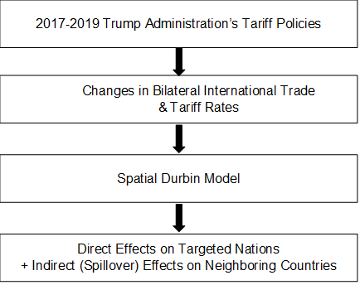

Slide 7
Data and Variables
Dependent variables: Net export & GDP
Independent variable: US tariff rate (AHS)
Spatial data: Country contiguity & economic proximity
Data sources: UN Comtrade, World Bank, WITS

Slide 8
Methodology
Descriptive statistics and correlation
Formal spatial tests: Moran’s I, LM tests
Spatial Durbin Model (SDM): 𝑌=𝜌𝑊𝑌+𝑋𝛽+𝑊𝑋𝜃+𝜀
Scaling variables for numerical stability

Slide 9
Interpretation and Conclusion
Wide variation in net exports and GDP across 195 countries
Negative correlation between net export and GDP (-0.91)
Weak correlation between tariffs and economic indicators

Slide 10
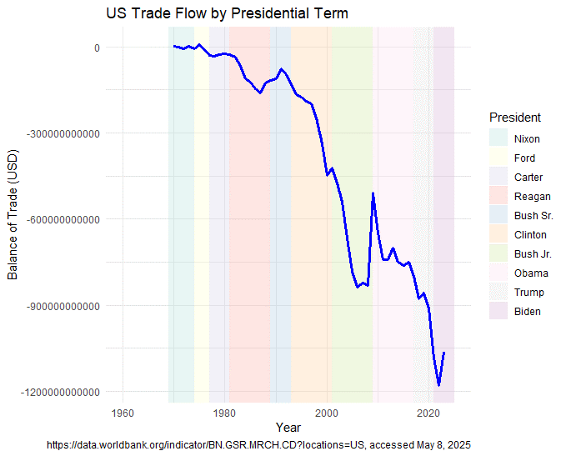
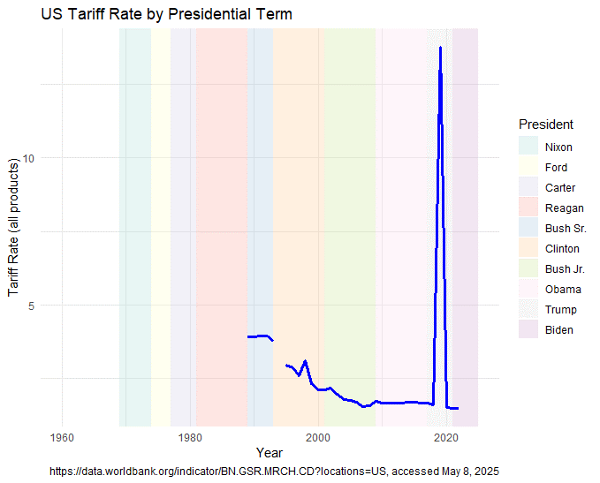

Slide 11
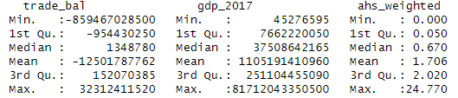

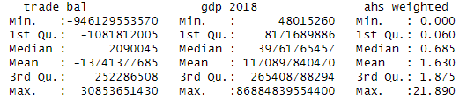

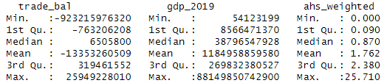


Slide 12
Interpretation and Conclusion
Significant positive Moran’s I for net export residuals indicating spatial autocorrelation
LM tests show weak spatial dependence, suggesting marginal spatial effects
SDM shows no significant improvement over OLS for tariffs impact on trade or GDP

Slide 13
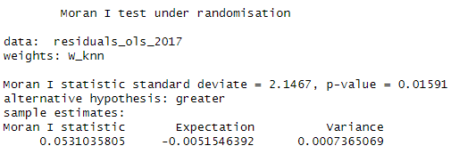
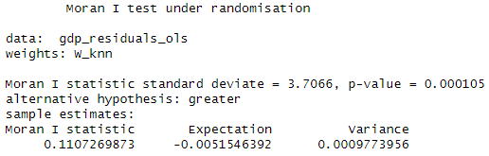
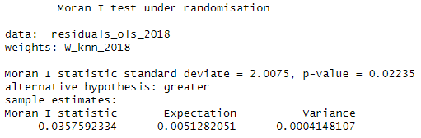
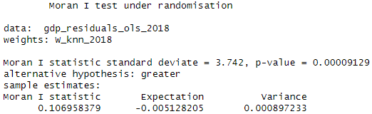
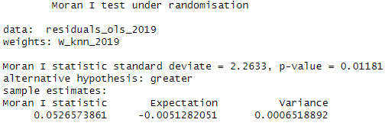
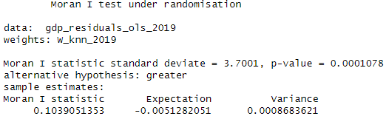

Slide 14
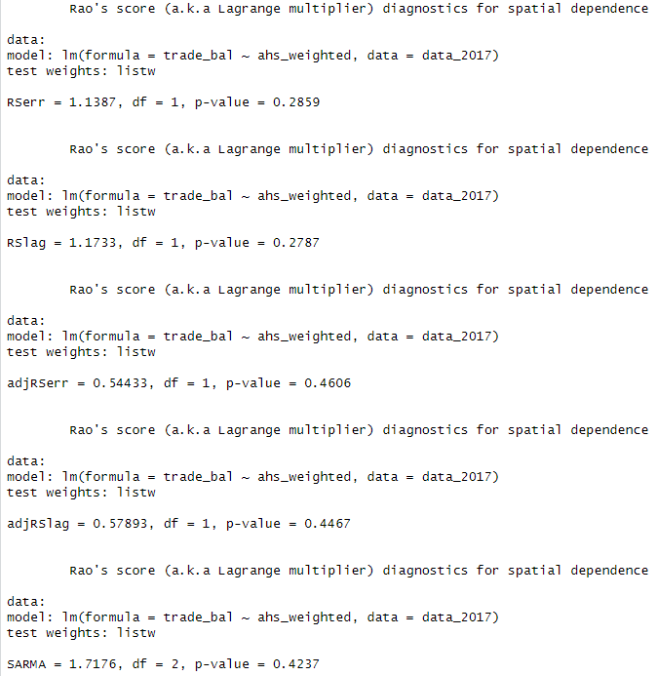
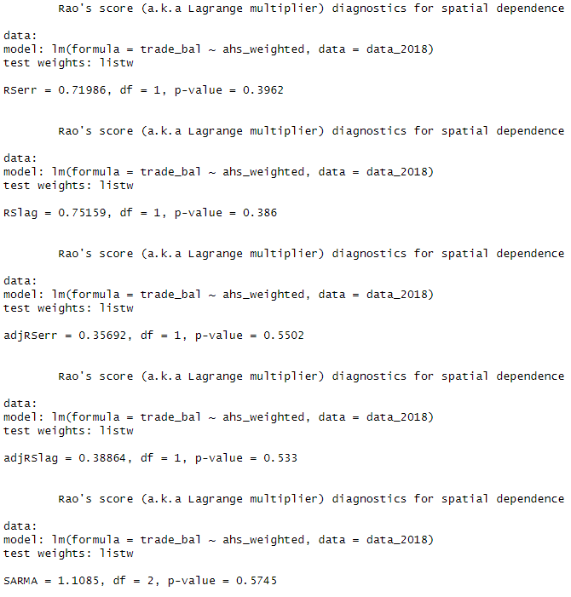
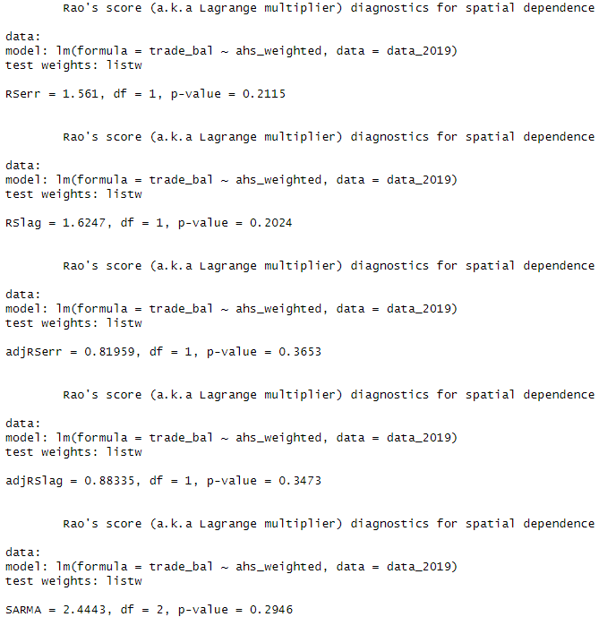

Slide 15
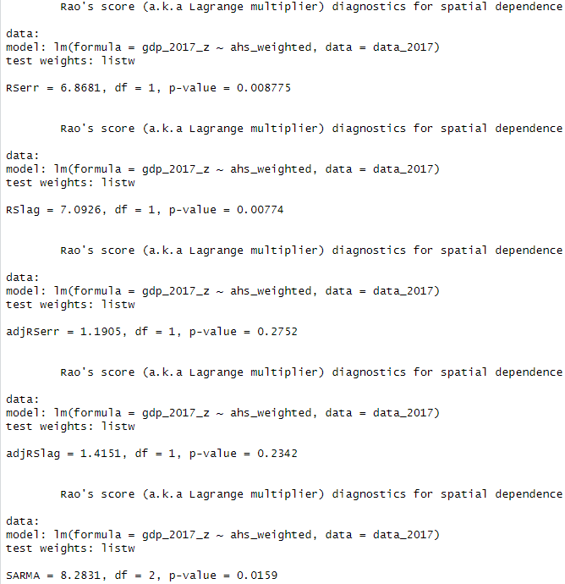
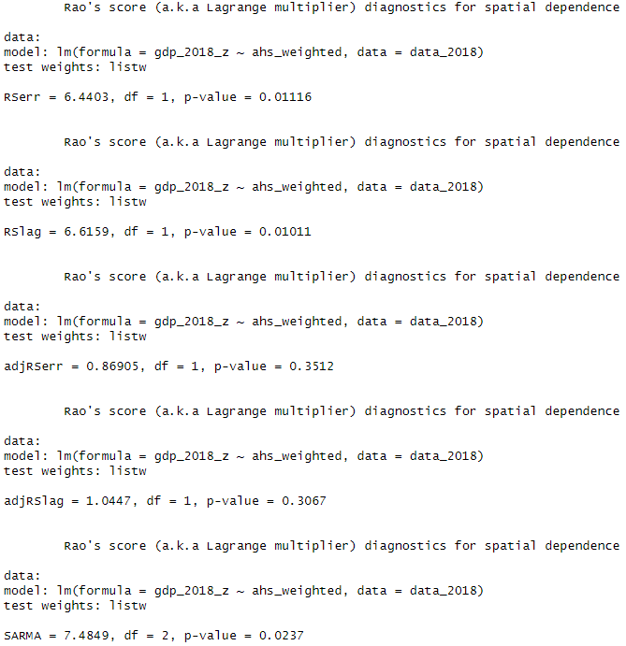
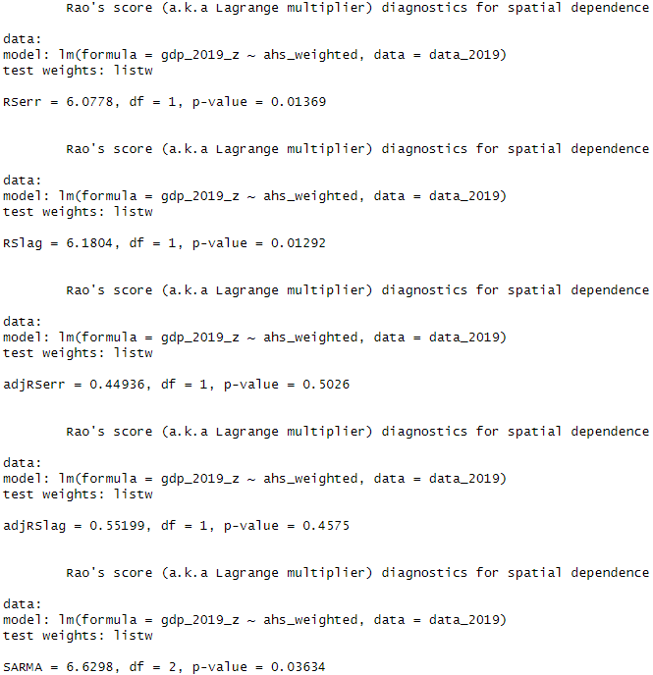

Slide 16
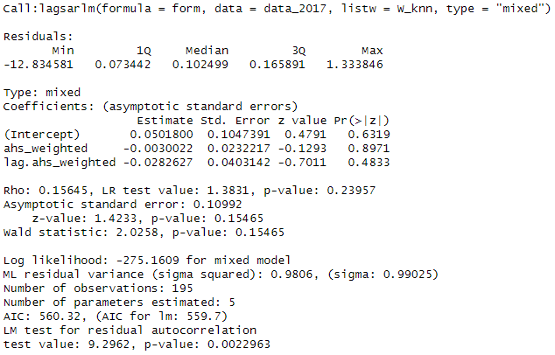
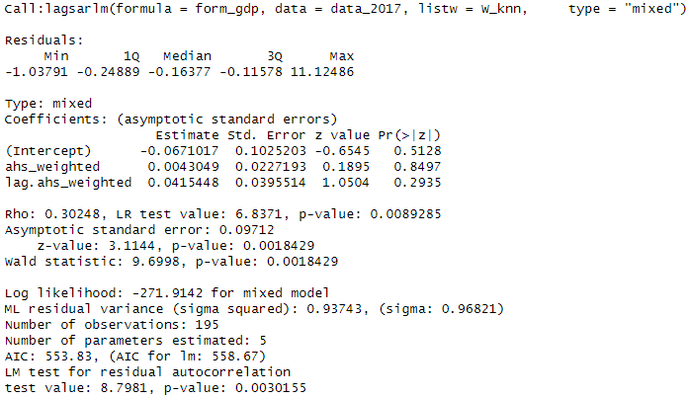
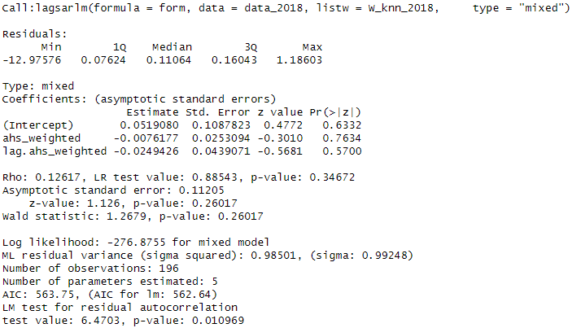
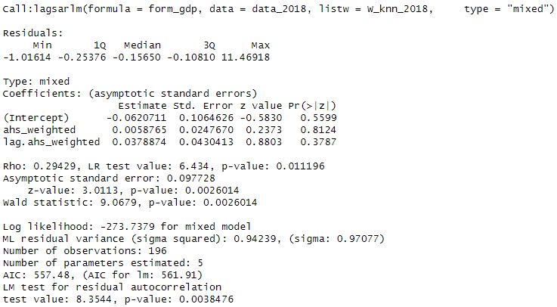
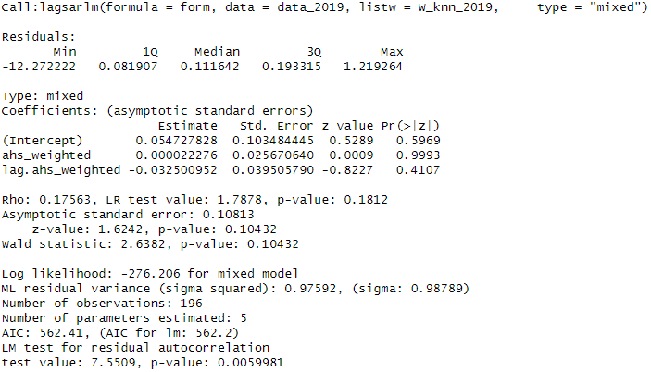
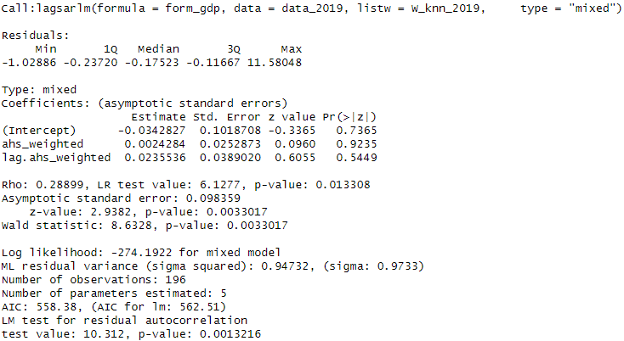

Slide 17
Interpretation and Conclusion
Tariffs had limited direct effects on US trade partners’ GDP and net export (2017–2019)
Spatial spillovers exist but are weak or insignificant in this data set

Slide 18
References
Altenberg, P., & Merkus, E. (2025). Tariffs do not Improve the Trade Balance. The National Board of Trade Sweden. Retrieved from https://www.kommerskollegium.se/globalassets/publikationer/rapporter/2025/tariffs-do-not-improve-the-trade-balance.pdf
Flaaen, A., & Pierce, J. (2019). Disentangling the Effects of the 2018-2019 Tariffs on a Globally Connected U.S. Manufacturing Sector. Finance and Economics Discussion Series 2019-086. Retrieved from https://www.federalreserve.gov/econres/feds/disentangling-the-effects-of-the-2018-2019-tariffs-on-a-globally-connected-us-manufacturing-sector.htm
Krugman, P. R., Obstfeld, M., & Melitz, M. J. (2012). International economics: Theory and policy (9th ed.). Pearson Education.
LeSage, J., & Pace, R. (2009). Introduction to spatial econometrics. Chapman & Hall/CRC. Retrieved from https://g-city.sass.org.cn/_upload/article/files/03/15/9d94a3194345bc4f0b8c8c9aed32/9bccc017-0b30-4b35-83eb-26052e2a48b7.pdf
Mateer, D., Coppock, L., & O’Roark, B. (2016). Essentials of economics (1st ed.). W. W. Norton & Company.
Parkin, M. (2012). Macroeconomics (10th ed.). Pearson Education.
Petri, P. A., & Banga, M. (2020). The Economic Consequences of Globalisation in the United States. ERIA Discussion Paper Series, 21. Retrieved from https://www.eria.org/uploads/media/discussion-papers/The-Economic-Consequences-of-Globalisation-in-the-United-States.pdf
Shatz, H. J. (2016, June 21). Charting the U.S. role in the world economy (RAND Research Brief RB-9918-RC). Retrieved from https://www.rand.org/content/dam/rand/pubs/research_briefs/RB9900/RB9918/RAND_RB9918.pdf
Smith, A. (1776). An Inquiry into the Nature and Causes of the Wealth of Nations. Retrieved from http://gesd.free.fr/smith76bis.pdf
wits.worldbank.org. (n.d.). Types of Tariff. Retrieved from https://wits.worldbank.org/wits/wits/witshelp/content/data_retrieval/p/intro/c2.types_of_tariffs.htm

Slide 19
https://github.com/wjdetomas/trump_tariffs_project
link to working files

